Slide 1
CS162 Operating Systems and Systems Programming Lecture 6 Synchronization 1: Concurrency
February 2nd, 2023
Prof. John Kubiatowicz
http://cs162.eecs.Berkeley.edu

Slide 2
Recall: Connection Setup over TCP/IP
Client Side
Server Side
Server
Socket
Server Listening:
Server IP addr
well-known port,
Protocol (TCP/IP)
Connection request:
Client IP addr
Client Port
Protocol (TCP/IP)
Request Connection
new
socket
socket
socket
connection
5-Tuple identifies each connection:
Source IP Address
Destination IP Address
Source Port Number
Destination Port Number
Protocol (always TCP here)
Often, Client Port “randomly” assigned
Done by OS during client socket setup
Server Port often “well known”
80 (web), 443 (secure web), 25 (sendmail), etc
Well-known ports from 0—1023

Slide 3


Recall: Web Server
Request
Reply
Client
Web Server

Slide 4
Recall: Sockets in concept
Client
Server
Create Server Socket
Create Client Socket
Bind it to an Address
(host:port)
Connect it to server (host:port)
Listen for Connection
Accept syscall()
Connection Socket
Connection Socket
write request
read request
read response
write response
Close Client Socket
Close Connection Socket
Close Server Socket

Slide 5
Recall: Client Protocol
char *host_name, *port_name;
// Create a socket
struct addrinfo *server = lookup_host(host_name, port_name);
int sock_fd = socket(server->ai_family, server->ai_socktype,
server->ai_protocol);
// Connect to specified host and port
connect(sock_fd, server->ai_addr, server->ai_addrlen);
// Carry out Client-Server protocol
run_client(sock_fd);
/* Clean up on termination */
close(sock_fd);
char *host_name, *port_name;
// Create a socket
struct addrinfo *server = lookup_host(host_name, port_name);
int sock_fd = socket(server->ai_family, server->ai_socktype,
server->ai_protocol);
// Connect to specified host and port
connect(sock_fd, server->ai_addr, server->ai_addrlen);
// Carry out Client-Server protocol
run_client(sock_fd);
/* Clean up on termination */
close(sock_fd);

Slide 6
Recall Client-Side: Getting the Server Address
struct addrinfo *lookup_host(char *host_name, char *port) {
struct addrinfo *server;
struct addrinfo hints;
memset(&hints, 0, sizeof(hints));
hints.ai_family = AF_UNSPEC; /* Includes AF_INET and AF_INET6 */
hints.ai_socktype = SOCK_STREAM; /* Essentially TCP/IP */
int rv = getaddrinfo(host_name, port_name,
&hints, &server);
if (rv != 0) {
printf("getaddrinfo failed: %s\n", gai_strerror(rv));
return NULL;
}
return server;
}

Slide 7
Recall: Server Protocol (v1)
// Create socket to listen for client connections
char *port_name;
struct addrinfo *server = setup_address(port_name);
int server_socket = socket(server->ai_family, server->ai_socktype, server->ai_protocol);
// Bind socket to specific port
bind(server_socket, server->ai_addr, server->ai_addrlen);
// Start listening for new client connections
listen(server_socket, MAX_QUEUE);
while (1) {
// Accept a new client connection, obtaining a new socket
int conn_socket = accept(server_socket, NULL, NULL);
serve_client(conn_socket);
close(conn_socket);
}
close(server_socket);
// Create socket to listen for client connections
char *port_name;
struct addrinfo *server = setup_address(port_name);
int server_socket = socket(server->ai_family, server->ai_socktype, server->ai_protocol);
// Bind socket to specific port
bind(server_socket, server->ai_addr, server->ai_addrlen);
// Start listening for new client connections
listen(server_socket, MAX_QUEUE);
while (1) {
// Accept a new client connection, obtaining a new socket
int conn_socket = accept(server_socket, NULL, NULL);
serve_client(conn_socket);
close(conn_socket);
}
close(server_socket);

Slide 8
Recall: Server Address: Itself (wildcard IP), Passive
struct addrinfo *setup_address(char *port) {
struct addrinfo *server;
struct addrinfo hints;
memset(&hints, 0, sizeof(hints));
hints.ai_family = AF_UNSPEC; /* Includes AF_INET and AF_INET6 */
hints.ai_socktype = SOCK_STREAM; /* Essentially TCP/IP */
hints.ai_flags = AI_PASSIVE; /* Set up for server socket */
int rv = getaddrinfo(NULL, port, &hints, &server); /* No address! (any local IP) */
if (rv != 0) {
printf("getaddrinfo failed: %s\n", gai_strerror(rv));
return NULL;
}
return server;
}
Accepts any connections on the specified port

Slide 9
How Could the Server Protect Itself?
Handle each connection in a separate process
This will mean that the logic serving each request will be “sandboxed” away from the main server process
In the following code, keep in mind:
fork() will duplicate all of the parent’s file descriptors (i.e. pointers to sockets!)
We keep control over accepting new connections in the parent
New child connection for each remote client

Slide 10
Sockets With Protection (each connection has own process)
Client
Server
Create Server Socket
Create Client Socket
Bind it to an Address
(host:port)
Connect it to server (host:port)
Listen for Connection
Accept syscall()
Connection Socket
Connection Socket
Child
Parent
Close Listen Socket
Close Connection Socket
write request
read request
read response
write response
Wait for child
Close Client Socket
Close Connection Socket
Close Server Socket

Slide 11
Server Protocol (v2)
// Socket setup code elided…
listen(server_socket, MAX_QUEUE);
while (1) {
// Accept a new client connection, obtaining a new socket
int conn_socket = accept(server_socket, NULL, NULL);
pid_t pid = fork();
if (pid == 0) {
close(server_socket);
serve_client(conn_socket);
close(conn_socket);
exit(0);
} else {
close(conn_socket);
wait(NULL);
}
}
close(server_socket);
// Socket setup code elided…
listen(server_socket, MAX_QUEUE);
while (1) {
// Accept a new client connection, obtaining a new socket
int conn_socket = accept(server_socket, NULL, NULL);
pid_t pid = fork();
if (pid == 0) {
close(server_socket);
serve_client(conn_socket);
close(conn_socket);
exit(0);
} else {
close(conn_socket);
wait(NULL);
}
}
close(server_socket);

Slide 12
How to make a Concurrent Server
So far, in the server:
Listen will queue requests
Buffering present elsewhere
But server waits for each connection to terminate before servicing the next
This is the standard shell pattern
A concurrent server can handle and service a new connection before the previous client disconnects
Simple – just don’t wait in parent!
Perhaps not so simple – multiple child processes better not have data races with one another through file system/etc!

Slide 13
Sockets With Protection and Concurrency
Client
Server
Create Server Socket
Create Client Socket
Bind it to an Address
(host:port)
Connect it to server (host:port)
Listen for Connection
Accept syscall()
Connection Socket
Connection Socket
Child
Parent
Close Listen Socket
Close Connection Socket
write request
read request
read response
write response
Close Client Socket
Close Connection Socket
Close Server Socket

Slide 14
Server Protocol (v3)
// Socket setup code elided…
listen(server_socket, MAX_QUEUE);
while (1) {
// Accept a new client connection, obtaining a new socket
int conn_socket = accept(server_socket, NULL, NULL);
pid_t pid = fork();
if (pid == 0) {
close(server_socket);
serve_client(conn_socket);
close(conn_socket);
exit(0);
} else {
close(conn_socket);
//wait(NULL);
}
}
close(server_socket);
// Socket setup code elided…
listen(server_socket, MAX_QUEUE);
while (1) {
// Accept a new client connection, obtaining a new socket
int conn_socket = accept(server_socket, NULL, NULL);
pid_t pid = fork();
if (pid == 0) {
close(server_socket);
serve_client(conn_socket);
close(conn_socket);
exit(0);
} else {
close(conn_socket);
//wait(NULL);
}
}
close(server_socket);

Slide 15
Faster Concurrent Server (without Protection)
Spawn a new thread to handle each connection
Lower overhead spawning process (less to do)
Main thread initiates new client connections without waiting for previously spawned threads
Why give up the protection of separate processes?
More efficient to create new threads
More efficient to switch between threads
Even more potential for data races (need synchronization?)
Through shared memory structures
Through file system

Slide 16
Sockets with Concurrency, without Protection
Client
Server
Create Server Socket
Create Client Socket
Bind it to an Address
(host:port)
Connect it to server (host:port)
Listen for Connection
Accept syscall()
Connection Socket
Connection Socket
pthread_create
Spawned Thread
write request
read request
Main Thread
read response
write response
Close Client Socket
Close Connection Socket
Close Server Socket

Slide 17
Thread Pools: More Later!
Problem with previous version: Unbounded Threads
When web-site becomes too popular – throughput sinks
Instead, allocate a bounded “pool” of worker threads, representing the maximum level of multiprogramming
Master
Thread
queue
Thread Pool
master() { allocThreads(worker,queue); while(TRUE) { con=AcceptCon(); Enqueue(queue,con); wakeUp(queue); } }
worker(queue) { while(TRUE) { con=Dequeue(queue); if (con==null) sleepOn(queue); else ServiceWebPage(con); } }

Slide 18
Administrivia
Project 1 in full swing! Released Yesterday!
We expect that your design document will give intuitions behind your designs, not just a dump of pseudo-code
Think of this you are in a company and your TA is you manager
Paradox: need code for design document?
Not full code, just enough prove you have thought through complexities of design
Should be attending your permanent discussion section!
Discussion section attendance is mandatory, but don’t come if sick!!
We have given a mechanism to make up for missed sections—see EdStem
Midterm 1: February 16th, 7-9PM (Two weeks from today!)
Fill out conflict request by tomorrow!

Slide 19
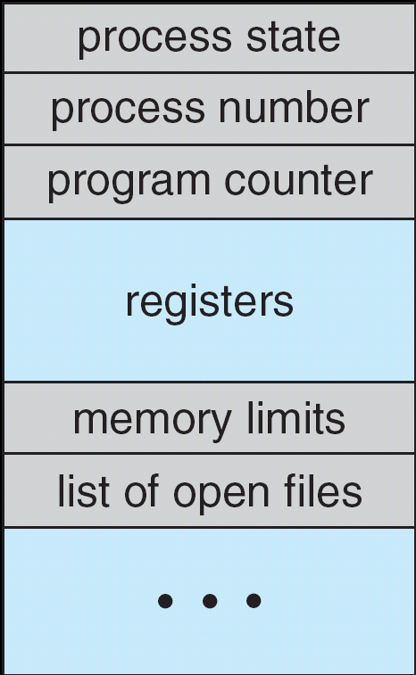
Recall: The Process Control Block
Kernel represents each process as a process control block (PCB)
Status (running, ready, blocked, …)
Register state (when not ready)
Process ID (PID), User, Executable, Priority, …
Execution time, …
Memory space, translation, …
Kernel Scheduler maintains a data structure containing the PCBs
Give out CPU to different processes
This is a Policy Decision
Give out non-CPU resources
Memory/IO
Another policy decision
Process Control
Block

Slide 20
Process-Specific File Descriptor Table inside Kernel
Process
Suppose that we execute
open(“foo.txt”)
and that the result is 3
Thread’s Regs
Address Space (Memory)
…
User Space
Kernel Space
File Descriptors
Open File Description
3
Not shown: Initially contains 0, 1, and 2 (stdin, stdout, stderr)
File: foo.txt
Position: 0

Slide 21
Process-Specific File Descriptor Table inside Kernel
Process
Suppose that we execute
open(“foo.txt”)
and that the result is 3
Next, suppose that we execute
read(3, buf, 100)
and that the result is 100
Thread’s Regs
Address Space (Memory)
…
User Space
Kernel Space
File Descriptors
Open File Description
3
Not shown: Initially contains 0, 1, and 2 (stdin, stdout, stderr)
File: foo.txt
Position: 0

Slide 22
Process-Specific File Descriptor Table inside Kernel
Process
Suppose that we execute
open(“foo.txt”)
and that the result is 3
Next, suppose that we execute
read(3, buf, 100)
and that the result is 100
Thread’s Regs
Address Space (Memory)
…
User Space
Kernel Space
File Descriptors
Open File Description
3
Not shown: Initially contains 0, 1, and 2 (stdin, stdout, stderr)
File: foo.txt
Position: 100

Slide 23
Process-Specific File Descriptor Table inside Kernel
Process
Suppose that we execute
open(“foo.txt”)
and that the result is 3
Next, suppose that we execute
read(3, buf, 100)
and that the result is 100
Finally, suppose that we execute
close(3)
Thread’s Regs
Address Space (Memory)
…
User Space
Kernel Space
File Descriptors
Open File Description
3
Not shown: Initially contains 0, 1, and 2 (stdin, stdout, stderr)
File: foo.txt
Position: 100

Slide 24
Instead of Closing, let’s fork()!
Process 1
Process 2
Thread’s Regs
Address Space (Memory)
File descriptor is copied
Open file description is aliased
Thread’s Regs
Address Space (Memory)
…
…
User Space
Kernel Space
File Descriptors
File Descriptors
Open File Description
3
3
Not shown: Initially contains 0, 1, and 2 (stdin, stdout, stderr)
File: foo.txt
Position: 100

Slide 25
Open File Description is Aliased
Process 1
Process 2
read(3, buf, 100)
Thread’s Regs
Address Space (Memory)
Thread’s Regs
Address Space (Memory)
…
…
User Space
Kernel Space
File Descriptors
File Descriptors
Open File Description
3
3
Not shown: Initially contains 0, 1, and 2 (stdin, stdout, stderr)
File: foo.txt
Position: 100

Slide 26
Open File Description is Aliased
Process 1
Process 2
read(3, buf, 100)
Thread’s Regs
Address Space (Memory)
Thread’s Regs
Address Space (Memory)
…
…
User Space
Kernel Space
File Descriptors
File Descriptors
Open File Description
3
3
Not shown: Initially contains 0, 1, and 2 (stdin, stdout, stderr)
File: foo.txt
Position: 200

Slide 27
Open File Description is Aliased
Process 1
Process 2
read(3, buf, 100)
read(3, buf, 100)
Thread’s Regs
Address Space (Memory)
Thread’s Regs
Address Space (Memory)
…
…
User Space
Kernel Space
File Descriptors
File Descriptors
Open File Description
3
3
Not shown: Initially contains 0, 1, and 2 (stdin, stdout, stderr)
File: foo.txt
Position: 200

Slide 28
Open File Description is Aliased
Process 1
Process 2
read(3, buf, 100)
read(3, buf, 100)
Thread’s Regs
Address Space (Memory)
Thread’s Regs
Address Space (Memory)
…
…
User Space
Kernel Space
File Descriptors
File Descriptors
Open File Description
3
3
Not shown: Initially contains 0, 1, and 2 (stdin, stdout, stderr)
File: foo.txt
Position: 300

Slide 29
File Descriptor is Copied
Process 1
Process 2
read(3, buf, 100)
close(3)
read(3, buf, 100)
Thread’s Regs
Address Space (Memory)
Thread’s Regs
Address Space (Memory)
…
…
User Space
Kernel Space
File Descriptors
File Descriptors
Open File Description
3
3
Not shown: Initially contains 0, 1, and 2 (stdin, stdout, stderr)
File: foo.txt
Position: 300

Slide 30
File Descriptor is Copied
Process 1
Process 2
read(3, buf, 100)
close(3)
read(3, buf, 100)
Thread’s Regs
Address Space (Memory)
Thread’s Regs
Address Space (Memory)
Open file description remains alive until no file descriptors in any process refer to it
…
…
User Space
Kernel Space
File Descriptors
File Descriptors
Open File Description
3
Not shown: Initially contains 0, 1, and 2 (stdin, stdout, stderr)
File: foo.txt
Position: 300

Slide 31
Why is Aliasing the Open File Description a Good Idea?
It allows for shared resources between processes

Slide 32
Example: Shared Terminal Emulator
When you fork() a process, the parent’s and child’s printf outputs go to the same terminal

Slide 33
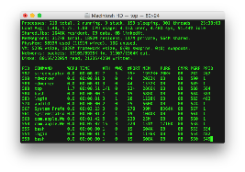
Example: Shared Terminal Emulator
Process 1
Process 2
Thread’s Regs
Address Space (Memory)
Thread’s Regs
Address Space (Memory)
…
…
User Space
Kernel Space
Terminal Emulator
File Descriptors
File Descriptors
0
1
2
0
1
2

Slide 34
Example: Shared Terminal Emulator
Process 1
Process 2
close(0)
Thread’s Regs
Address Space (Memory)
Thread’s Regs
Address Space (Memory)
…
…
User Space
Kernel Space
Terminal Emulator
File Descriptors
File Descriptors
0
1
2
0
1
2

Slide 35
Example: Shared Terminal Emulator
Process 1
Process 2
close(0)
Thread’s Regs
Address Space (Memory)
Thread’s Regs
Address Space (Memory)
If one process closes stdin (0), it remains open in other processes
…
…
User Space
Kernel Space
Terminal Emulator
File Descriptors
File Descriptors
0
1
2
0
1
2

Slide 36
Other Examples
Shared network connections after fork()
Allows handling each connection in a separate process
We saw this in our Webserver examples
Pipes – channel for communication
int pipe(int pipefd[2]); /* Create array of two file descriptors */
Writes to pipefd[1] can be read from pipefd[0]
Useful for interprocess communication:
after fork(), both parent and child can communicate (one can read what other one writes)
And in writing a shell (Homework 2)

Slide 37
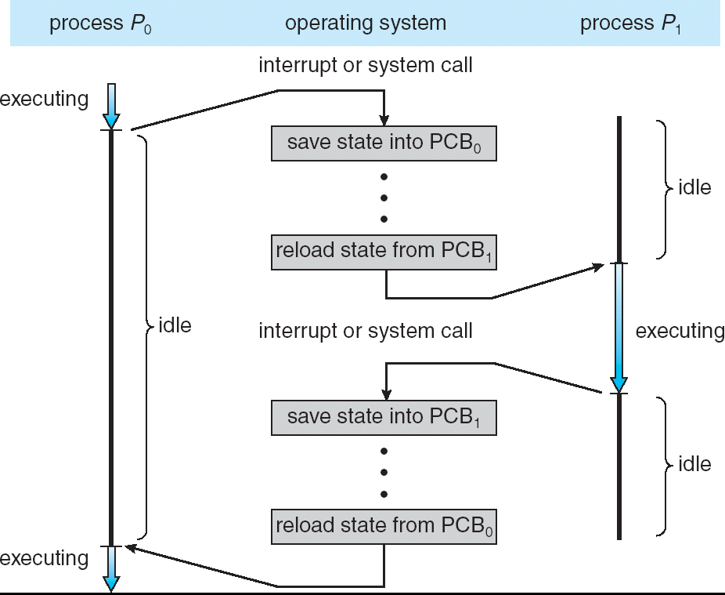
Recall: CPU Switch From Process A to Process B
User Mode
Kernel/System Mode
User Mode

Slide 38
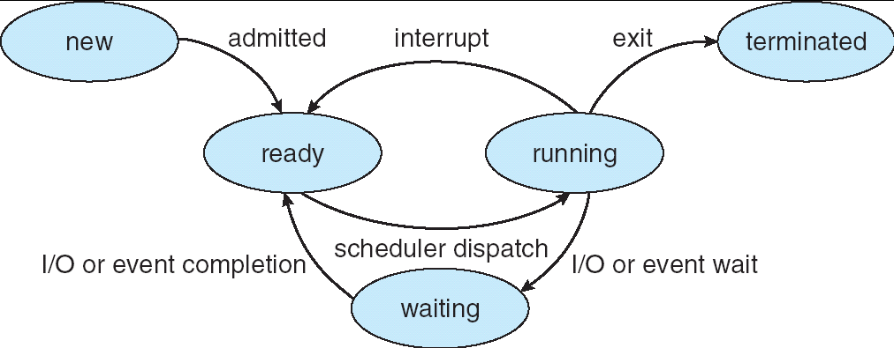
Lifecycle of a Process
As a process executes, it changes state:
new: The process is being created
ready: The process is waiting to run
running: Instructions are being executed
waiting: Process waiting for some event to occur
terminated: The process has finished execution

Slide 39
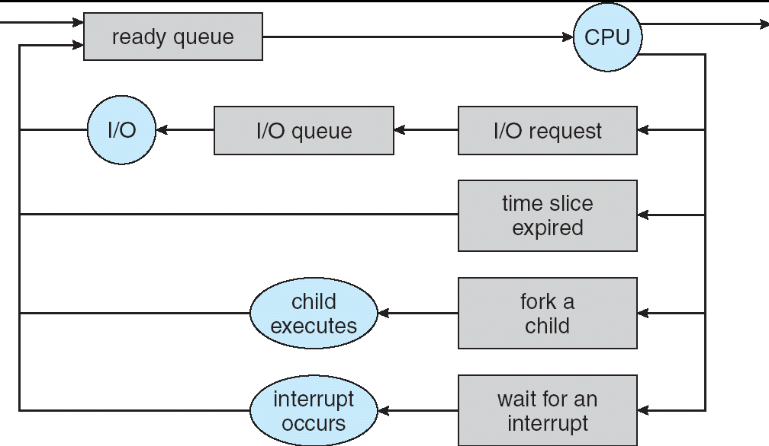
Process Scheduling
PCBs move from queue to queue as they change state
Decisions about which order to remove from queues are Scheduling decisions
Many algorithms possible (few weeks from now)

Slide 40
Ready Queue And Various I/O Device Queues
Process not running ⇒ PCB is in some scheduler queue
Separate queue for each device/signal/condition
Each queue can have a different scheduler policy
Ready
Queue
Head
Other
State
PCB₉
Link
Other
State
PCB₆
Link
Other
State
PCB₁₆
Link
Tail
Registers
Registers
Registers
USB
Unit 0
Head
Tail
Disk
Unit 0
Head
Other
State
PCB₂
Link
Other
State
PCB₃
Link
Tail
Registers
Registers
Disk
Unit 2
Head
Tail
Other
State
PCB₈
Ether
Netwk 0
Link
Head
Tail
Registers

Slide 41
Modern Process with Threads
Thread: a sequential execution stream within process (Sometimes called a “Lightweight process”)
Process still contains a single Address Space
No protection between threads
Multithreading: a single program made up of a number of different concurrent activities
Sometimes called multitasking, as in Ada …
Why separate the concept of a thread from that of a process?
Discuss the “thread” part of a process (concurrency)
Separate from the “address space” (protection)
Heavyweight Process ≡ Process with one thread

Slide 42
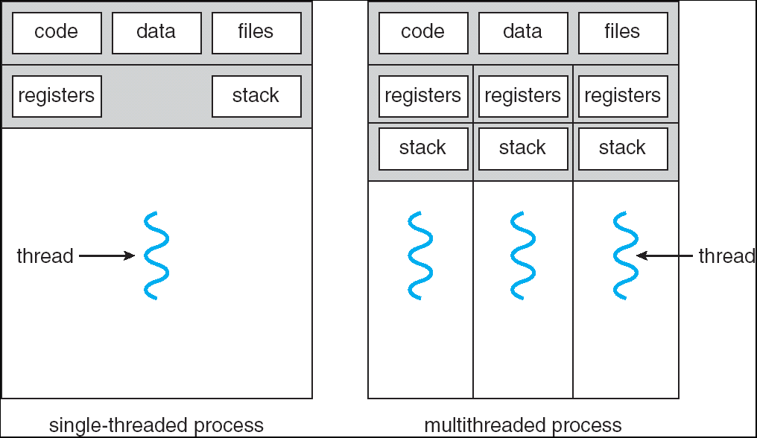
Single and Multithreaded Processes
Threads encapsulate concurrency: “Active” component
Address spaces encapsulate protection: “Passive” part
Keeps buggy program from trashing the system
Why have multiple threads per address space?
Notes:
Sometimes need parallelism for a single job, and processes are very expensive – to start, switch between, and to communicate between

Slide 43
Thread State
State shared by all threads in process/address space
Content of memory (global variables, heap)
I/O state (file descriptors, network connections, etc)
State “private” to each thread
Kept in TCB ≡ Thread Control Block
CPU registers (including, program counter)
Execution stack – what is this?
Execution Stack
Parameters, temporary variables
Return PCs are kept while called procedures are executing

Slide 44
Shared vs. Per-Thread State

Slide 45
Example: Execution Stack Example
A(int tmp) {
if (tmp<2)
B();
printf(tmp);
}
B() {
C();
}
C() {
A(2);
}
A(1);
A:
A+1:
A+2:
B:
B+1:
C:
C+1:
exit:
Stack holds temporary results
Permits recursive execution
Crucial to modern languages

Slide 46
Execution Stack Example
A: tmp=1
ret=exit
A(int tmp) {
if (tmp<2)
B();
printf(tmp);
}
B() {
C();
}
C() {
A(2);
}
A(1);
Stack
Pointer
A:
A+1:
A+2:
B:
B+1:
C:
C+1:
exit:
Stack holds temporary results
Permits recursive execution
Crucial to modern languages

Slide 47
Execution Stack Example
A: tmp=1
ret=exit
A(int tmp) {
if (tmp<2)
B();
printf(tmp);
}
B() {
C();
}
C() {
A(2);
}
A(1);
Stack
Pointer
A:
A+1:
A+2:
B:
B+1:
C:
C+1:
exit:
Stack holds temporary results
Permits recursive execution
Crucial to modern languages

Slide 48
Execution Stack Example
A: tmp=1
ret=exit
A(int tmp) {
if (tmp<2)
B();
printf(tmp);
}
B() {
C();
}
C() {
A(2);
}
A(1);
Stack
Pointer
A:
A+1:
A+2:
B:
B+1:
C:
C+1:
exit:
Stack holds temporary results
Permits recursive execution
Crucial to modern languages

Slide 49
Execution Stack Example
A: tmp=1
ret=exit
A(int tmp) {
if (tmp<2)
B();
printf(tmp);
}
B() {
C();
}
C() {
A(2);
}
A(1);
A:
A+1:
A+2:
B:
B+1:
C:
C+1:
exit:
B: ret=A+2
Stack
Pointer
Stack holds temporary results
Permits recursive execution
Crucial to modern languages

Slide 50
Execution Stack Example
A: tmp=1
ret=exit
A(int tmp) {
if (tmp<2)
B();
printf(tmp);
}
B() {
C();
}
C() {
A(2);
}
A(1);
A:
A+1:
A+2:
B:
B+1:
C:
C+1:
exit:
B: ret=A+2
Stack
Pointer
Stack holds temporary results
Permits recursive execution
Crucial to modern languages

Slide 51
Execution Stack Example
A: tmp=1
ret=exit
A(int tmp) {
if (tmp<2)
B();
printf(tmp);
}
B() {
C();
}
C() {
A(2);
}
A(1);
A:
A+1:
A+2:
B:
B+1:
C:
C+1:
exit:
B: ret=A+2
C: ret=B+1
Stack
Pointer
Stack holds temporary results
Permits recursive execution
Crucial to modern languages

Slide 52
Execution Stack Example
A: tmp=1
ret=exit
A(int tmp) {
if (tmp<2)
B();
printf(tmp);
}
B() {
C();
}
C() {
A(2);
}
A(1);
A:
A+1:
A+2:
B:
B+1:
C:
C+1:
exit:
B: ret=A+2
C: ret=B+1
A: tmp=2
ret=C+1
Stack
Pointer
Stack Growth
Stack holds temporary results
Permits recursive execution
Crucial to modern languages

Slide 53
Execution Stack Example
A: tmp=1
ret=exit
A(int tmp) {
if (tmp<2)
B();
printf(tmp);
}
B() {
C();
}
C() {
A(2);
}
A(1);
A:
A+1:
A+2:
B:
B+1:
C:
C+1:
exit:
B: ret=A+2
C: ret=B+1
A: tmp=2
ret=C+1
Stack
Pointer
Stack Growth
Output:
>2
Stack holds temporary results
Permits recursive execution
Crucial to modern languages

Slide 54
Execution Stack Example
A: tmp=1
ret=exit
A(int tmp) {
if (tmp<2)
B();
printf(tmp);
}
B() {
C();
}
C() {
A(2);
}
A(1);
A:
A+1:
A+2:
B:
B+1:
C:
C+1:
exit:
B: ret=A+2
C: ret=B+1
A: tmp=2
ret=C+1
Stack
Pointer
Stack Growth
Output:
>2
Stack holds temporary results
Permits recursive execution
Crucial to modern languages

Slide 55
Execution Stack Example
A: tmp=1
ret=exit
A(int tmp) {
if (tmp<2)
B();
printf(tmp);
}
B() {
C();
}
C() {
A(2);
}
A(1);
A:
A+1:
A+2:
B:
B+1:
C:
C+1:
exit:
B: ret=A+2
C: ret=B+1
Stack
Pointer
Output:
>2
Stack holds temporary results
Permits recursive execution
Crucial to modern languages

Slide 56
Execution Stack Example
A: tmp=1
ret=exit
A(int tmp) {
if (tmp<2)
B();
printf(tmp);
}
B() {
C();
}
C() {
A(2);
}
A(1);
A:
A+1:
A+2:
B:
B+1:
C:
C+1:
exit:
B: ret=A+2
Stack
Pointer
Output:
>2
Stack holds temporary results
Permits recursive execution
Crucial to modern languages

Slide 57
Execution Stack Example
A: tmp=1
ret=exit
A(int tmp) {
if (tmp<2)
B();
printf(tmp);
}
B() {
C();
}
C() {
A(2);
}
A(1);
Stack
Pointer
A:
A+1:
A+2:
B:
B+1:
C:
C+1:
exit:
Output:
>2 1
Stack holds temporary results
Permits recursive execution
Crucial to modern languages

Slide 58
Execution Stack Example
A: tmp=1
ret=exit
A(int tmp) {
if (tmp<2)
B();
printf(tmp);
}
B() {
C();
}
C() {
A(2);
}
A(1);
Stack
Pointer
A:
A+1:
A+2:
B:
B+1:
C:
C+1:
exit:
Output:
>2 1
Stack holds temporary results
Permits recursive execution
Crucial to modern languages

Slide 59
Execution Stack Example
A(int tmp) {
if (tmp<2)
B();
printf(tmp);
}
B() {
C();
}
C() {
A(2);
}
A(1);
Output:
>2 1
Stack holds temporary results
Permits recursive execution
Crucial to modern languages

Slide 60
Execution Stack Example
A: tmp=1
ret=exit
A(int tmp) {
if (tmp<2)
B();
printf(tmp);
}
B() {
C();
}
C() {
A(2);
}
A(1);
Stack
Pointer
B: ret=A+2
C: ret=b+1
A: tmp=2
ret=C+1
Stack Growth
Stack holds temporary results
Permits recursive execution
Crucial to modern languages

Slide 61
Motivational Example for Threads
Imagine the following C program:
main() {
ComputePI(“pi.txt”);
PrintClassList(“classlist.txt”);
}
What is the behavior here?
Program would never print out class list
Why? ComputePI would never finish

Slide 62
Use of Threads
Version of program with Threads (loose syntax):
main() {
ThreadFork(ComputePI, “pi.txt” ));
ThreadFork(PrintClassList, “classlist.txt”));
}
What does ThreadFork() do?
Start independent thread running given procedure
What is the behavior here?
Now, you would actually see the class list
This should behave as if there are two separate CPUs
CPU1
CPU2
CPU1
CPU2
CPU1
CPU2
Time

Slide 63
Memory Footprint: Two-Threads
If we stopped this program and examined it with a debugger, we would see
Two sets of CPU registers
Two sets of Stacks
Questions:
How do we position stacks relative to each other?
What maximum size should we choose for the stacks?
What happens if threads violate this?
How might you catch violations?
Stack 1
Stack 2
Address Space
Heap
Global Data
Code

Slide 64
OS Library API for Threads: pthreads
pThreads: POSIX standard for thread programming [POSIX.1c, Threads extensions (IEEE Std 1003.1c-1995)]
int pthread_create(pthread_t *thread, const pthread_attr_t *attr, void *(*start_routine)(void*), void *arg);
thread is created executing start_routine with arg as its sole argument.
return is implicit call to pthread_exit
void pthread_exit(void *value_ptr);
terminates the thread and makes value_ptr available to any successful join
int pthread_yield();
causes the calling thread to yield the CPU to other threads
int pthread_join(pthread_t thread, void **value_ptr);
suspends execution of the calling thread until the target thread terminates.
On return with a non-NULL value_ptr the value passed to pthread_exit() by the terminating thread is made available in the location referenced by value_ptr.
prompt% man pthread
https://pubs.opengroup.org/onlinepubs/7908799/xsh/pthread.h.html

Slide 65
The Core of Concurrency: the Dispatch Loop
Conceptually, the scheduling loop of the operating system looks as follows:
Loop {
RunThread();
ChooseNextThread();
SaveStateOfCPU(curTCB);
LoadStateOfCPU(newTCB);
}
This is an infinite loop
One could argue that this is all that the OS does
Should we ever exit this loop???
When would that be?
Notes:
Emergency crash of operating system called “panic()”

Slide 66
Running a thread
Consider first portion: RunThread()
How do I run a thread?
Load its state (registers, PC, stack pointer) into CPU
Load environment (virtual memory space, etc)
Jump to the PC
How does the dispatcher get control back?
Internal events: thread returns control voluntarily
External events: thread gets preempted
Notes:
OS’s have almost human characteristics – unpredictable, hard to understand, …
Different things share the same CPU – one thread, then another
Similar to schizophrenia, like the movie Sybil, one body shared by several people, say we start with Dave Patterson
Threads are like the personalities of the CPU. First one thread/personality uses the CPU, then another,…

Slide 67
Internal Events
Blocking on I/O
The act of requesting I/O implicitly yields the CPU
Waiting on a “signal” from other thread
Thread asks to wait and thus yields the CPU
Thread executes a yield()
Thread volunteers to give up CPU
computePI() {
while(TRUE) {
ComputeNextDigit();
yield();
}
}
Notes:
Yield is for really nice people – Ever see two people at the supermarket checkout line? You first, no you first, …

Slide 68
Stack for Yielding Thread
ComputePI
yield
Trap to OS
kernel_yield
Stack growth
run_new_thread
switch
How do we run a new thread?
run_new_thread() {
newThread = PickNewThread();
switch(curThread, newThread);
ThreadHouseKeeping(); /* Do any cleanup */
}
How does dispatcher switch to a new thread?
Save anything next thread may trash: PC, regs, stack pointer
Maintain isolation for each thread

Slide 69
What Do the Stacks Look Like?
Consider the following code blocks:
proc A() {
B();
}
proc B() {
while(TRUE) {
yield();
}
}
Suppose we have 2 threads:
Threads S and T
Thread S
Thread T
A
A
B(while)
B(while)
Stack growth
yield
yield
run_new_thread
run_new_thread
switch
switch
Thread S's switch returns to Thread T's (and vice versa)

Slide 70
Saving/Restoring state (often called “Context Switch)
Switch(tCur,tNew) {
/* Unload old thread */
TCB[tCur].regs.r7 = CPU.r7;
…
TCB[tCur].regs.r0 = CPU.r0;
TCB[tCur].regs.sp = CPU.sp;
TCB[tCur].regs.retpc = CPU.retpc; /*return addr*/
/* Load and execute new thread */
CPU.r7 = TCB[tNew].regs.r7;
…
CPU.r0 = TCB[tNew].regs.r0;
CPU.sp = TCB[tNew].regs.sp;
CPU.retpc = TCB[tNew].regs.retpc;
return; /* Return to CPU.retpc */
}

Slide 71
Switch Details (continued)
What if you make a mistake in implementing switch?
Suppose you forget to save/restore register 32
Get intermittent failures depending on when context switch occurred and whether new thread uses register 32
System will give wrong result without warning
Can you devise an exhaustive test to test switch code?
No! Too many combinations and inter-leavings
Cautionary tale:
For speed, Topaz kernel saved one instruction in switch()
Carefully documented! Only works as long as kernel size < 1MB
What happened?
Time passed, People forgot
Later, they added features to kernel (no one removes features!)
Very weird behavior started happening
Moral of story: Design for simplicity

Slide 72
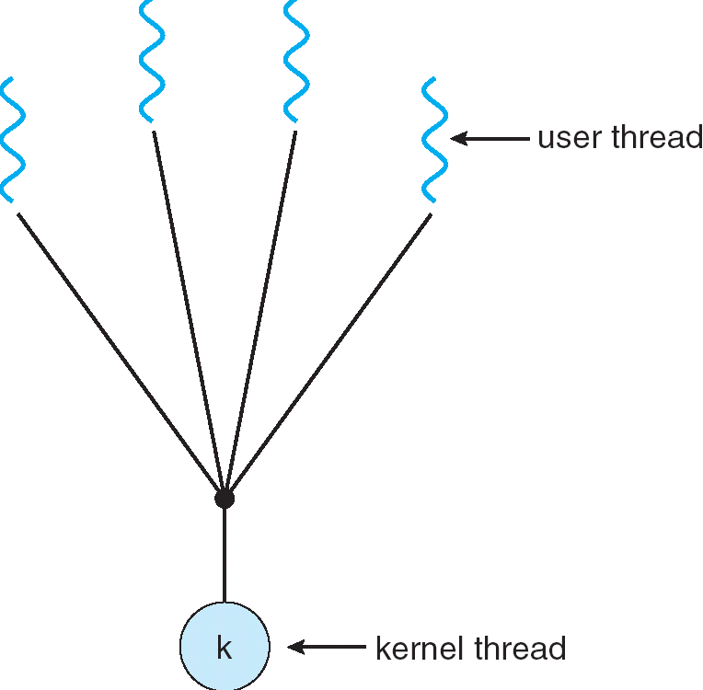
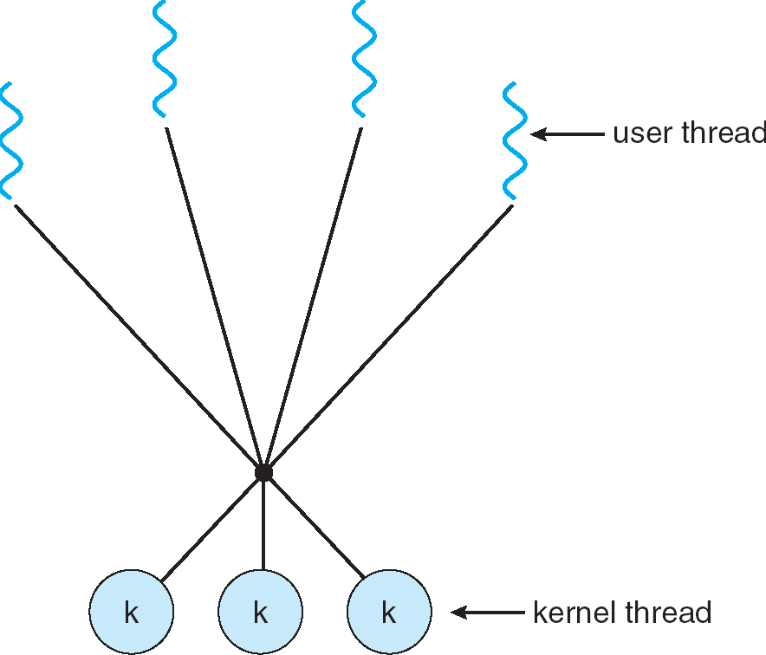
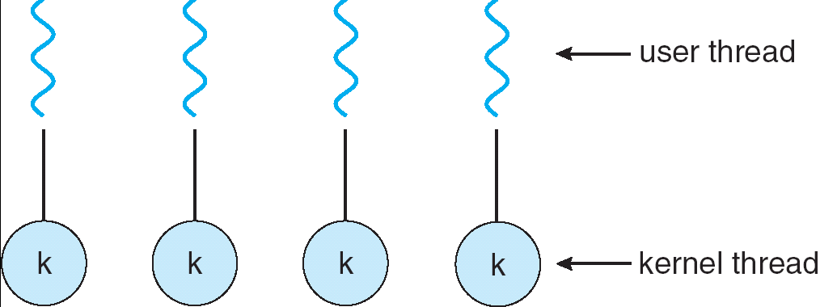
How expensive is context switching?
Switching between threads in same process similar to switching between threads in different processes, but much cheaper:
No need to change address space
Some numbers from Linux:
Frequency of context switch: 10-100ms
Switching between processes: 3-4 μsec.
Switching between threads: 100 ns
Even cheaper: switch threads (using “yield”) in user-space!
What we are talking about in Today’s lecture
Simple One-to-One
Threading Model
Many-to-One
Many-to-Many

Slide 73
What happens when thread blocks on I/O?
CopyFile
read
Trap to OS
Stack growth
kernel_read
run_new_thread
switch
What happens when a thread requests a block of data from the file system?
User code invokes a system call
Read operation is initiated
Run new thread/switch
Thread communication similar
Wait for Signal/Join
Networking

Slide 74
External Events
What happens if thread never does any I/O, never waits, and never yields control?
Could the ComputePI program grab all resources and never release the processor?
What if it didn’t print to console?
Must find way that dispatcher can regain control!
Answer: utilize external events
Interrupts: signals from hardware or software that stop the running code and jump to kernel
Timer: like an alarm clock that goes off every some milliseconds
If we make sure that external events occur frequently enough, can ensure dispatcher runs
Notes:
Patterson’s a nice guy, so he gives up the body after using it for awhile and let’s John Kubitowicz have it.
But Kubi’s not so nice, so he won’t give up control…
If you want to wake up for a final, you set your clock, or ask your roommate to pour water over your head – OS does the same

Slide 75
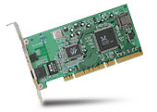
Recall: Interrupt Controller
Interrupt Mask
Priority Encoder
IntID
CPU
Interrupt
Int Disable
Timer
Software
Interrupt
Control
NMI
Network
Interrupts invoked with interrupt lines from devices
Interrupt controller chooses interrupt request to honor
Interrupt identity specified with ID line
Mask enables/disables interrupts
Priority encoder picks highest enabled interrupt
Software Interrupt Set/Cleared by Software
CPU can disable all interrupts with internal flag
Non-Maskable Interrupt line (NMI) can’t be disabled

Slide 76
Example: Network Interrupt
Raise priority
(set mask)
Reenable All Ints
Save registers
Dispatch to Handler
…
Transfer Network Packet from hardware to Kernel Buffers
…
Restore registers
Clear current Int
Disable All Ints
Restore priority
(clear Mask)
RTI
...
add $r1,$r2,$r3
subi $r4,$r1,#4
slli $r4,$r4,#2
...
PC saved
Disable All Ints
Kernel Mode
External Interrupt
Pipeline Flush
“Interrupt Handler”
...
lw $r2,0($r4)
lw $r3,4($r4)
add $r2,$r2,$r3
sw 8($r4),$r2
...
Restore PC
Enable all Ints
User Mode
An interrupt is a hardware-invoked context switch
No separate step to choose what to run next
Always run the interrupt handler immediately

Slide 77
Use of Timer Interrupt to Return Control
Solution to our dispatcher problem
Use the timer interrupt to force scheduling decisions
Timer Interrupt routine:
TimerInterrupt() { DoPeriodicHouseKeeping(); run_new_thread(); }
Some Routine
Interrupt
TimerInterrupt
Stack growth
run_new_thread
switch

Slide 78
ThreadFork(): Create a New Thread
ThreadFork() is a user-level procedure that creates a new thread and places it on ready queue
Arguments to ThreadFork()
Pointer to application routine (fcnPtr)
Pointer to array of arguments (fcnArgPtr)
Size of stack to allocate
Implementation
Sanity check arguments
Enter Kernel-mode and Sanity Check arguments again
Allocate new Stack and TCB
Initialize TCB and place on ready list (Runnable)

Slide 79
How do we initialize TCB and Stack?
Initialize Register fields of TCB
Stack pointer made to point at stack
PC return address ⇒ OS (asm) routine ThreadRoot()
Two arg registers (a0 and a1) initialized to fcnPtr and fcnArgPtr, respectively
Initialize stack data?
Minimal initialization ⇒setup return to go to beginning of ThreadRoot()
Important part of stack frame is in registers for RISC-V (ra)
X86: need to push a return address on stack
Think of stack frame as just before body of ThreadRoot() really gets started
ThreadRoot stub
Stack growth
Initial Stack

Slide 80
How does Thread get started?
Other Thread
ThreadRoot
A
B(while)
Stack growth
yield
run_new_thread
New Thread
switch
ThreadRoot stub
Eventually, run_new_thread() will select this TCB and return into beginning of ThreadRoot()
This really starts the new thread

Slide 81
How does a thread get started?
Other Thread
SetupNewThread(tNew) {
…
TCB[tNew].regs.sp = newStackPtr;
TCB[tNew].regs.retpc = &ThreadRoot;
TCB[tNew].regs.r0 = fcnPtr TCB[tNew].regs.r1 = fcnArgPtr
}
ThreadRoot
A
B(while)
Stack growth
yield
run_new_thread
New Thread
switch
ThreadRoot stub
How do we make a new thread?
Setup TCB/kernel thread to point at new user stack and ThreadRoot code
Put pointers to start function and args in registers or top of stack
This depends heavily on the calling convention (i.e. RISC-V vs x86)
Eventually, run_new_thread() will select this TCB and return into beginning of ThreadRoot()
This really starts the new thread

Slide 82
What does ThreadRoot() look like?
ThreadRoot() is the root for the thread routine:
ThreadRoot(fcnPTR,fcnArgPtr) {
DoStartupHousekeeping();
UserModeSwitch(); /* enter user mode */
Call fcnPtr(fcnArgPtr);
ThreadFinish();
}
Startup Housekeeping
Includes things like recording start time of thread
Other statistics
Stack will grow and shrink with execution of thread
Final return from thread returns into ThreadRoot() which calls ThreadFinish()
ThreadFinish() wake up sleeping threads
ThreadRoot
Thread Code *fcnPtr()
Stack growth
Running Stack

Slide 83
Processes vs. Threads: One Core
Process 1
Process N
Switch overhead:
Same process: low
Different proc.: high
Protection
Same proc: low
Different proc: high
Sharing overhead
Same proc: low
Different proc: high
Parallelism: no
threads
threads
Mem.
Mem.
…
IO
state
…
…
IO
state
CPU
state
CPU
state
CPU
state
CPU
state
CPU sched.
OS
1 thread at a time
CPU
(1 core)

Slide 84
Processes vs. Threads: MultiCore
Process 1
Process N
Switch overhead:
Same process: low
Different proc.: high
Protection
Same proc: low
Different proc: high
Sharing overhead
Same proc: low
Different proc, simultaneous core: medium
Different proc, offloaded core: high
Parallelism: yes
threads
threads
Mem.
Mem.
…
IO
state
…
…
IO
state
CPU
state
CPU
state
CPU
state
CPU
state
CPU sched.
OS
4 threads at a time
Core 1
Core 2
Core 3
Core 4

Slide 85
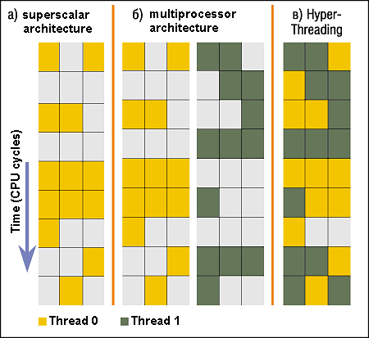
Recall: Simultaneous MultiThreading/Hyperthreading
Hardware scheduling technique
Superscalar processors can execute multiple instructions that are independent.
Hyperthreading duplicates register state to make a second “thread,” allowing more instructions to run.
Can schedule each thread as if were separate CPU
But, sub-linear speedup!
Original technique called “Simultaneous Multithreading”
http://www.cs.washington.edu/research/smt/index.html
SPARC, Pentium 4/Xeon (“Hyperthreading”), Power 5
Colored blocks show
instructions executed
Notes:
Intel seems to be discarding SMT in Silvermont because of power problems

Slide 86
Processes vs. Threads: Hyper-Threading
Process 1
Process N
threads
threads
Switch overhead between hardware-threads: very-low (done in hardware)
Contention for ALUs/FPUs may hurt performance
Mem.
Mem.
…
IO
state
…
…
IO
state
CPU
state
CPU
state
CPU
state
CPU
state
CPU sched.
OS
hardware-threads
(hyperthreading)
8 threads at a time
Core 1
Core 2
Core 3
Core 4
CPU

Slide 87
Threads vs Address Spaces: Options
One
Many
# of addr spaces:
# threads
Per AS:
One
MS/DOS, early Macintosh
Traditional UNIX
Many
Embedded systems (Geoworks, VxWorks, JavaOS,etc)
JavaOS, Pilot(PC)
Mach, OS/2, Linux
Windows 10
Win NT to XP, Solaris, HP-UX, OS X
Most operating systems have either
One or many address spaces
One or many threads per address space

Slide 88
Conclusion
Recall: open(), read(), write(), and close() used for wide variety of I/O:
Files on disk
Devices (terminals, printers, etc.)
Regular files on disk
Networking (sockets)
Local interprocess communication (pipes, sockets)
Processes have two parts
Threads (Concurrency)
Address Spaces (Protection)
Stack is essential part of computation
Every thread has two stacks: user-level (in address space) and kernel
The kernel stack + support often called the “kernel thread”
Various textbooks talk about processes
When this concerns concurrency, really talking about thread portion of a process
When this concerns protection, talking about address space portion of a process

